Slide 1



Working with Input Stream
  Scenario:
Needs to develop a Java application that converts the documents from one format into another, such as .txt into .pdf.
To develop such an application, a develop need to read data from an input stream, such as a file.
A developer

Slide 2
Working with Input Stream (Contd.)
  Scenario (Contd.):
To read data in the form of characters, Java provides the Reader classes inside the java.io package.

Slide 3
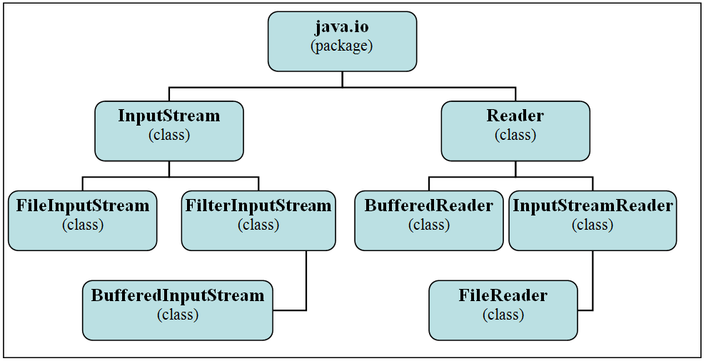
Working with Input Stream (Contd.)
  The following figure shows the commonly used input stream class hierarchy of the java.io package.

Slide 4
Using the FileInputStream Class
  The FileInputStream class is used to read data and the steams of bytes from the file.
  Some of the constructs of the FileInputStream class are:
    FileInputStream(File file)
    FileInputStream(FileDescriptor fdObj)
    FileInputStream(String name)
  Some of the methods of the FileInputStream class are:
    int read()
    FileDescriptor getFD()
  Consider the code given in the embedded document to read the data from a file:

Slide 5
Using the BufferedInputStream Class
  The BufferedInputStream class is used to perform the read operations by using a temporary storage, buffer, in the memory.
  A buffer is used to store the retrieved data when the first system call to read data is made.
  The retrieval of data by using a buffer instead of a system call is much faster; and hence, it improves the efficiency of the program.
  Some of the constructs of the BufferedInputStream class are:
    BufferedInputStream(InputStream in)
    BufferedInputStream(InputStream in, int size)
  Some of the methods of the BufferedInputStream class are:
    int available()
    void mark(int readlimit)
    void reset()
    boolean markSupported()
    void close()

Slide 6
Using the BufferedInputStream Class (Contd.)
    int read(byte[] b, int off,int len)
    long skip(long n)
  Consider the following code of BufferedInputStream that prints the output on the console:
  import java.io.BufferedInputStream;
  import java.io.ByteArrayInputStream;
  import java.io.IOException;
  public class BufferedInputStreamDemo
  {
  public static void main(String[] args)
  {
  String s = "This is a BufferedInputStream Demo Program";
  byte buf[] = s.getBytes();

Slide 7
Using the BufferedInputStream Class (Contd.)
  try(ByteArrayInputStream in = new ByteArrayInputStream(buf);
  BufferedInputStream f = new BufferedInputStream(in)){
  int c;
  while ((c = f.read()) != -1)
  {
  System.out.print((char) c);
  }
  }
  catch(IOException e)
  {
  System.out.println(e);
  }
  }
  }

Slide 8
Using the FileReader Class
  The FileReader class is used for reading characters from a file, but it does not define any method of its own.
  The FileReader class derives all the methods from its base classes, such as the Reader and InputStreamReader classes.
  Some of the constructs of the FileReader class are:
    FileReader(File file)
    FileReader(FileDescriptor fd)
    FileReader(String fileName)
  Consider the code given in the embedded document that reads data from the file:

Slide 9
Using the BufferedReader Class
  The BufferedReader class is used to read the text from a character-input stream, such as a file, console, and array, while buffering characters.
  As the data is buffered, the read operation becomes more efficient using the BufferedReader class.
  Some of the constructs of the BufferedReader class are:
    BufferedReader(Reader in)
    BufferedReader(Reader in, int sz)
  Some of the methods of the BufferedReader class are:
    void mark(int readAheadLimit)
    boolean markSupported()
    String readLine()
    boolean ready()

Slide 10
Using the BufferedReader Class (Contd.)
  Consider the code given in the embedded document that accepts two numbers from the user by using the BufferedReader class and prints the sum of these two numbers:

Slide 11
Just a minute
  Which one of the following methods is used to ensure that the close() method of the FileInputStream is called when there are no more references to it?
    finalize()
    ready()
    reset()
    close()

Slide 12
Just a minute (Contd.)
  Solution:
    finalize()

Slide 13
Summary
  In this session, you learned that:
    The following synchronizer classes are available:
      Semaphore
      CountdownLatch
      CyclicBarrier
      Phaser
      Exchanger
    The use of the collection classes improves the performance of a concurrent application and improves its scalability by allowing multiple threads to share a data collection.
    The executors can be used effectively to manage the thread tasks, such as their instantiation and execution, which improve the performance of an application when working with a large number of threads.

Slide 14

Summary (Contd.)
    The Executor interface is used to execute tasks by using an executor.
    ExecutorService provides the additional methods that add more functionality for managing the tasks of an executor, such as shutting it down.
    The fork/join framework is based on the principle of decomposing a larger task into smaller tasks until it cannot be further broken down.
    Java handles all the input and output operations in the form of streams that act as a sequence of bytes or characters traveling from a source to a destination.
    When a stream of data is being sent, it is said to be written; and when a stream of data is being received, it is said to be read.
    To read data in the form of characters, Java provides the Reader classes inside the java.io package.
    The FileInputStream class is used to read data and the
    steams of bytes from the file.

Slide 15
Summary (Contd.)
    The BufferedInputStream class is used to perform the read operations by using a temporary storage, buffer, in the memory.
    The FileReader class is used for reading characters from a file, but it does not define any method of its own.
    The BufferedReader class is used to read the text from a
    character-input stream, such as a file, console, and array, while buffering characters.

